Slide 1

Comparison of Feature Extraction Methods for Vehicle Detection
Team: Jaya Sai Karanam
Kiruthika Varatharajan
Sharanya Reddy Konda

Slide 2
Contents:
Abstract
Introduction to Object Identification
Feature Extraction in Images
Data Set
Feature Extraction Methods
Results
Conclusion

Slide 3
Abstract:
Our goal is to test different feature extraction methods used on images and identify the best feature extraction method to used to classify images with vehicles.

Slide 4
Introduction to Object Identification:
It is a technology related to Computer Vision and image processing that deals with detecting objects of a class.
For example: Humans, Cats, Cars etc.

Slide 5
What is Feature Extraction in Images?
Feature extraction is a process of dimensionality reduction, where input data is reduced and only useful features are extracted for training purposes.
Advantages:
Accuracy improvements.
Overfitting risk reduction.
Speed up in training.
Improved Data Visualization.
Increase in explainability of our model.

Slide 6
Data Set:
Data set consists of images with and without vehicles
Images are shot from Far, Middle close, Right, Left views.
There are 4925 images containing vehicles.
There are 4900 images containing no vehicles i.e., empty roads.
Each image is of size 64x64.

Slide 7
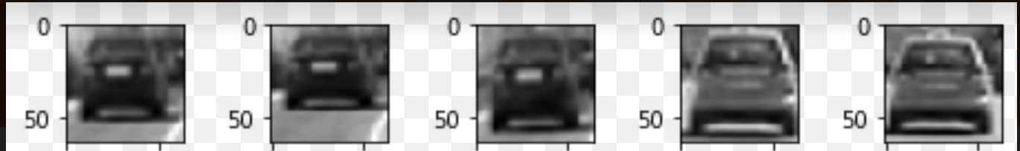
Sample of input images: with Vehicles

Slide 8
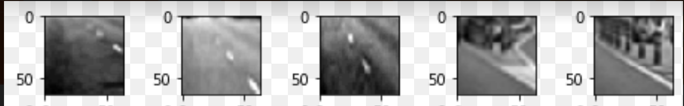
Sample of input images: Without Vehicles:

Slide 9
Feature Extraction Methods:
Prewitt
Image Segmentation
Sobel
Contouring
Histogram of Oriented Gradients

Slide 10
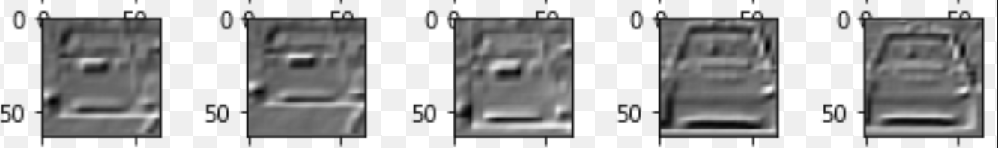
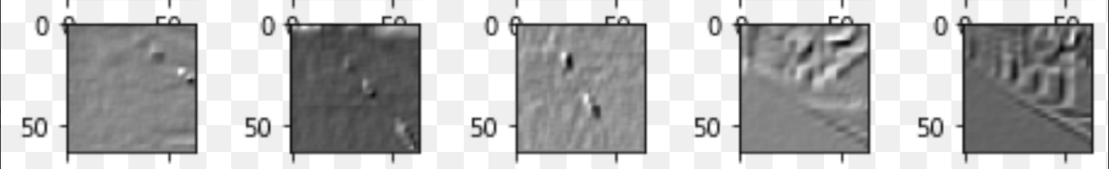
Prewitt

Slide 11
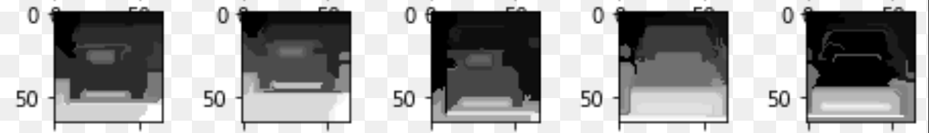
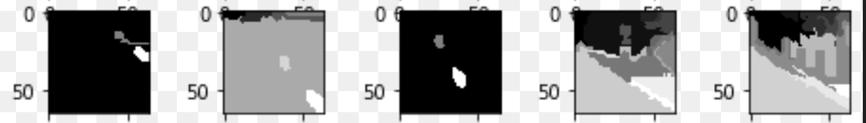
Image segmentation:

Slide 12
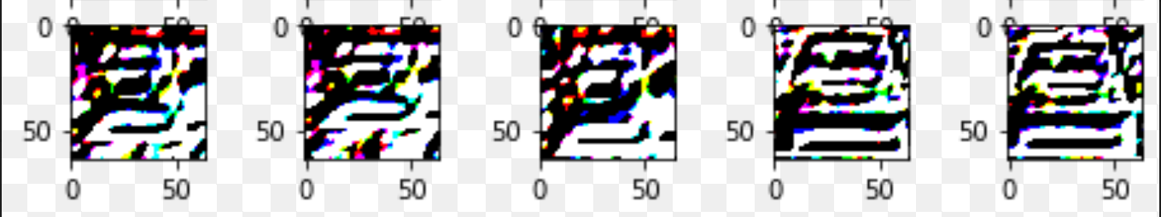
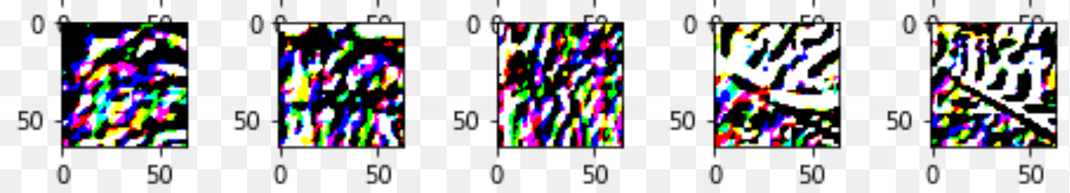
Sobel

Slide 13
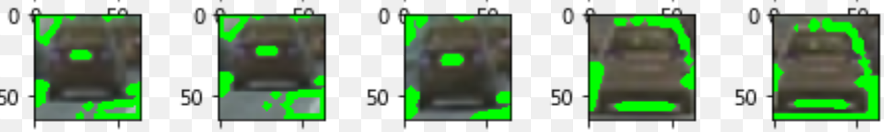
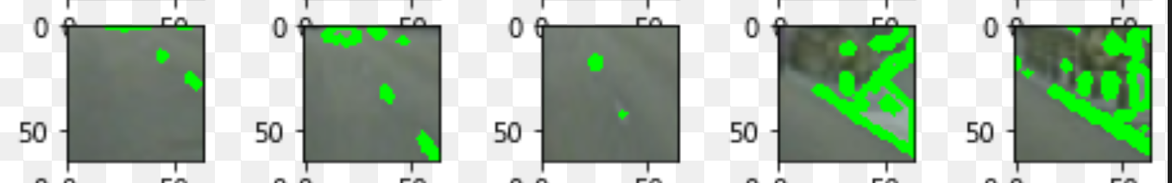
Contouring:

Slide 14
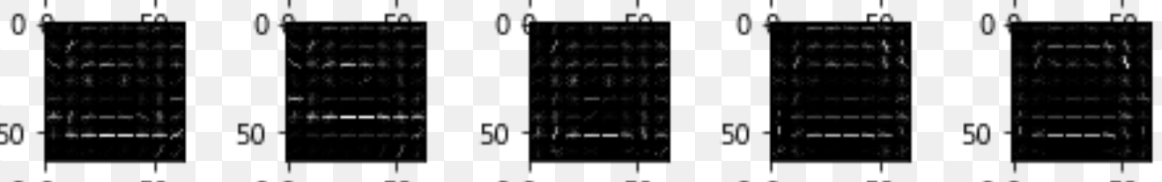
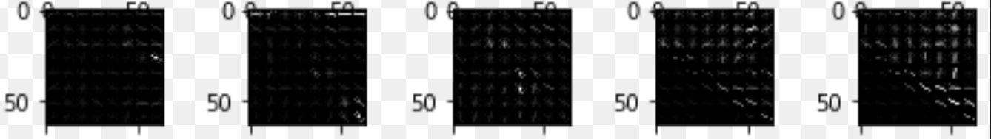
Histogram of Oriented Gradients

Slide 15
Tools used:
Sklearn
OS
Skimage
Scipy
Python
Tensorflow
Math
Numpy
CV2
Glob
Matplotlib
Random

Slide 16
Results: Comparison of the Feature Extraction Methods
Method | Accuracy
Without Filter | 85.73 %
Prewitt | 77.54%
Image Segmentation | 78.02%
Sobel | 88.94%
Contouring | 91.74%
Histogram of Oriented Gradients | 94.54%

Slide 17
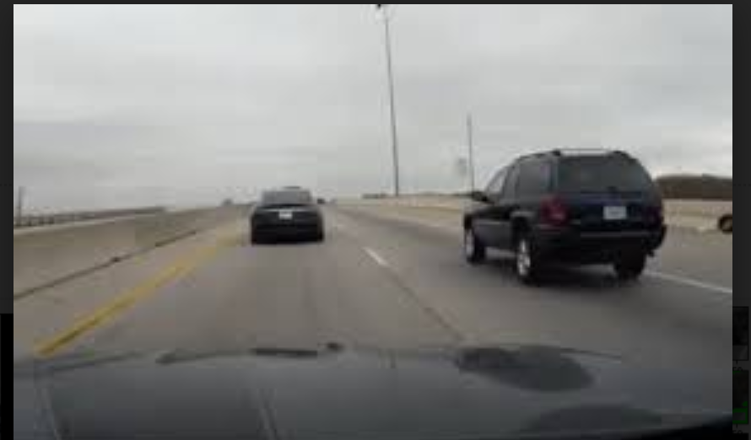
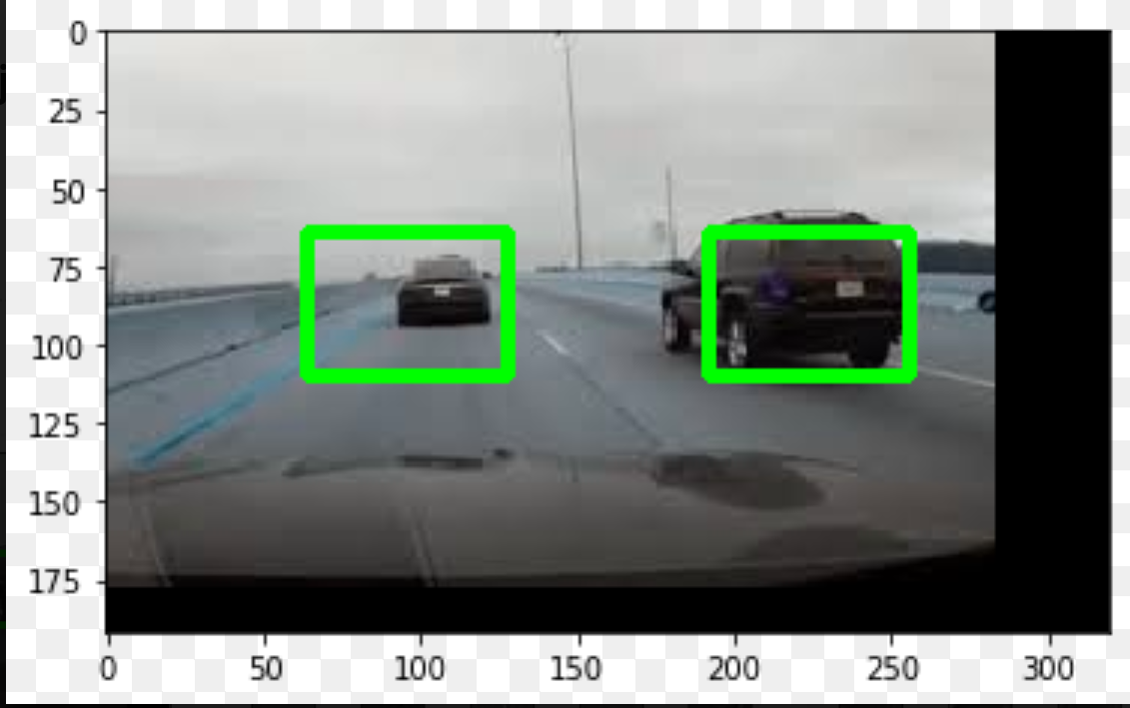
Test Image and Output: With HOG filter

Slide 18
Conclusion
Feature Extraction methods have improved the accuracy when compared to image identification without any filters.
Histogram of Oriented Gradients gave the best accuracy, followed by contouring.
Histograms work well, especially with SVMs.
We have attached the explanation of code as video in the next slide.

Slide 19


Slide 20
Thank you

